Slide 1

Stock Market Prediction using Granger’s causality test as a data pre-processor
By,
Akshay Dhonthi Ramesh Babu - 1887502
Fabian Humberto Fonseca Aponte - 1886565
David Esteban Imbajoa Ruiz - 1922212
Academic Year 2019 − 2020

Slide 2
Introduction
The stock market fluctuation is too rough and sometimes unpredictable even with proper tools and indicators. However, the future price prediction of a financial asset is essential for investors.
The near future prediction can reduce the risk on decision of an appropriate investment asset. This kind of prediction can lead to gain in steady incomes.
Over the decade, large number of techniques has been developed out of which RNN has shown a great improvement converging into LSTM thanks to the data driven decision making.
Many times, the stocks of certain companies depend on others. Finding the correct causation between the companies may help in better predictions.

Slide 3
Objective
The presentation will cover the following section of the project:
Problem Statement: The purpose of the project.
Methodology: Methods and algorithms used
Experiments: Hypotheses and partial results of the performed experiments.
Results and Conclusion: Final results obtained and evaluation of the performance of the implementation.

Slide 4
Problem Statement
Explore the different alternatives for a stock market prediction that considers the possible relations between companies and compare the results obtained

Slide 5

Dataset - Yahoo Finance
The dataset is loaded directly into python from Yahoo Finance using their API.
A select number of companies (approx. 100) are chosen in advance.
Each company has four time series data columns (open, high, low and close).
The dataset is structured into single data frame with all the companies.
The original dataset is modified with respect to the needs or the possible augmentation of its information.

Slide 6
Methodology
Feature Engineering
Formatting of the data
Data augmentation with stock market related variables
Preliminary Development
Prediction with LSTM - Individual
Prediction with LSTM - Combined
Prediction with BERT
Causation Matrix Development
Granger Causality test
Correlated Development
Prediction with LSTM - Filtered

Slide 7
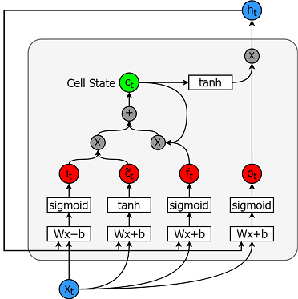
Methodology - LSTM
The LSTM is a special kind of RNN which is able to keep long term dependencies and in-turn solve the vanishing gradient problem
The advantage of using LSTM is its ability to process sequential data.
Each line carries an entire vector, from the output of one node to the inputs of others.
The grey circles represent pointwise operations, like vector addition, while the white boxes are learned neural network layers

Slide 8
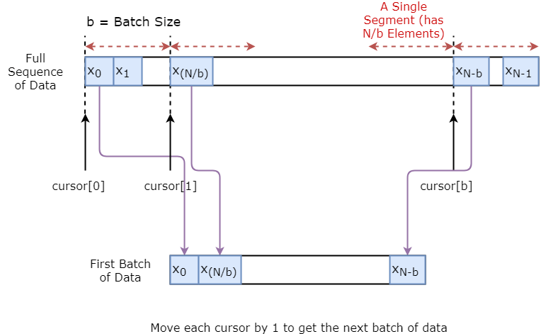
Methodology - LSTM (Data Generator)
The basic idea is that we divide the data sequence to N/b segments.
Define cursors, 1 for each segment.
To sample a single batch of data, we get one input and one true prediction.
At the end of each sampling, we increase the cursor by 1.
Final number of batches depends on the user-defined time step.

Slide 9
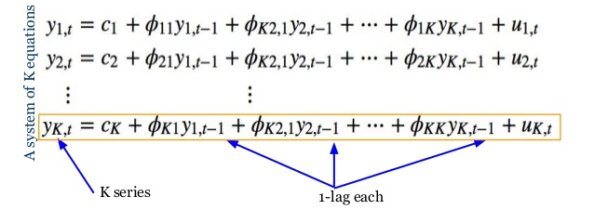
Methodology - Causation Matrix
Vector Autoregressive Model
This VAR model is a linear combination of past values of itself and the past values of other variables in the system.
As there are multiple time series that influence each other, VAR is modeled as a system of equations with one equation per time series.
For example, If there are two time serie, two compute one time series, the past values of both time series is used.
Image from: https://www.slideshare.net/databricks/time-series-forecasting-using-recurrent-neural-network-and-vector

Slide 10
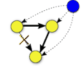
Methodology - Causation Matrix
Granger’s Causality Test
The idea behind VAR is to predict the series with past values of itself along with other series in the system.
Granger’s causality tests the null hypothesis that the coefficients of past values in the regression equation is zero
Image from: https://link.springer.com/chapter/10.1007/978-1-84996-196-7_5

Slide 11
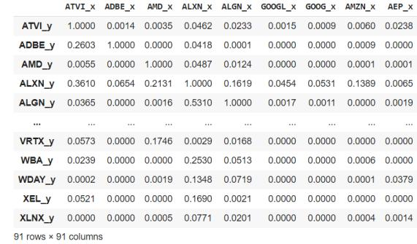
Implementation - Granger’s Causality test
The test is to check granger causality of all possible combinations of the n Time series. Where n is the number of companies.
The test returns an nXn matrix. With the rows being the time series in interest and the columns being the company to check if it affects the time series in interest based on the past values of both.
If the significance level is less than 0.05, then the the column time series does not cause the row time series.

Slide 12
Implementation
Custom databases
Extended features DB: Includes all the features extracted from the original columns provided by the Yahoo Finance API [open, high, low, close].
Extended by companies DB: Uses the most relevant features from all the companies and integrate its columns to the dataset to find external support on the prediction.
Filtered Company DB:
Use the causation matrix to estimate the companies with the highest contribution to the predicted company and from them the Dataset used is extended.

Slide 13
Implementation - Extended features DB
The indicators are calculated from time series data adjusted to eliminate artificial price or volume shocks.
(BBANDS)
Bolligin bands
(SMA)
Simple moving average.
(MACD)
moving average convergence/divergence.
(RSI)
Relative Strength Index.
(KDJ)
Stochastic Oscillator

Slide 14
Implementation - Extended by company DB
4 Features from Yahoo Finance
(Close, High, Low, Open)
4 Features/Company
Total: 4*98 = 392
Normalization
Range: 0 to 1
98 Total Companies
Each Company
Reduced features from the PCA allows to integrate external factors such as companies from the sector.
The network should be able to recognize the internal relationships between companies during the training and consider it in the weights.

Slide 15
Implementation - Filtered by causation matrix DB
4 Features from Yahoo Finance
(Close, High, Low, Open)
Granger’s Causality Test on one feature: ‘Close’
Take top 10 companies showing causality on the selected company
98 Total Companies
98X98 Causation Matrix
Each Company
Normalization
Range: 0 to 1
4 Features/Company + 10 features from causality test
Total: 4 + 10*4 = 44
Using a filter is possible reduce the stress in the training by not including all the companies from the web scraping.
The causation matrix will ensure that the data feeded into the network comes from the most related companies.

Slide 16
Experimentation - Expected Results
Single company: Limited performance due to the missing information from external variables
Extended by companies: Expensive training due to the large amount of information included, but with better performance due to the external factor included
Initial Development
Implemented properly it will provide a reference to asociate companies that may influence the behavour of the predicted one
Causation Matrix Development
The preprocessing step of filtering the unrelated companies will reduce the resources needed to train and provide a better context of the external factors
Filtering with Causation Matrix

Slide 17
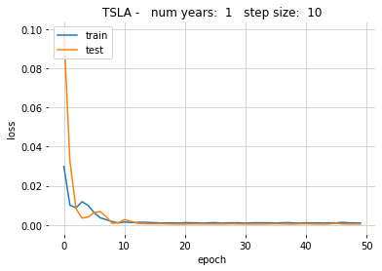
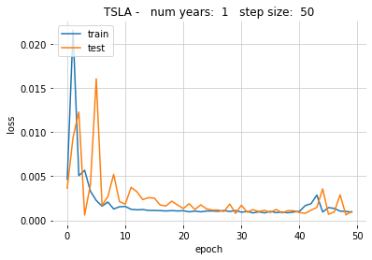
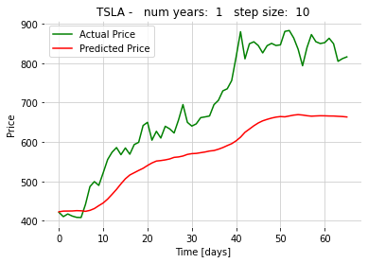
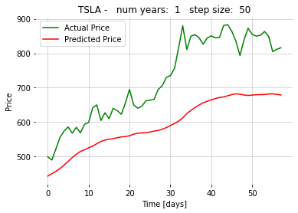
Experimentation - 1 Year Single
Company: Tesla Duration: 1 year Time step: 50, 10 steps Batch size: 64 windows Feature set: Single Epochs: 50

Slide 18
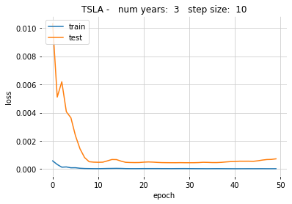
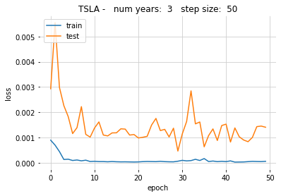
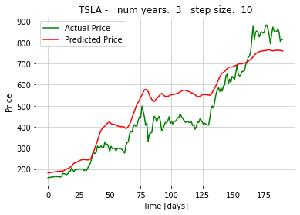
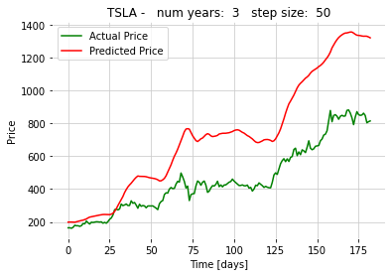
Experimentation - 3 Years ingle
Company: Tesla Duration: 3 years Time step: 50, 10 steps Batch size: 64 windows Feature set: Single Epochs: 50

Slide 19
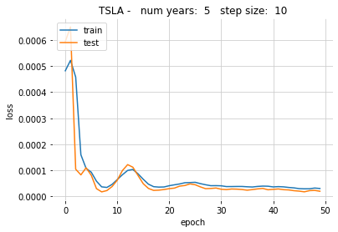
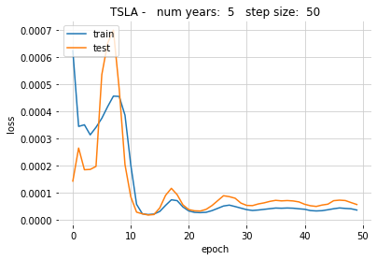
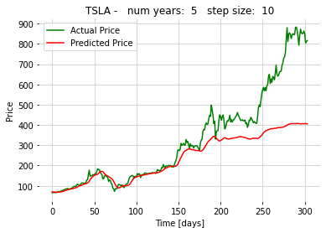
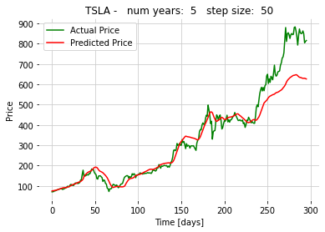
Experimentation - 5 Years Single
Company: Tesla Duration: 5 years Time step: 50, 10 steps Batch size: 64 windows Feature set: Single Epochs: 50

Slide 20
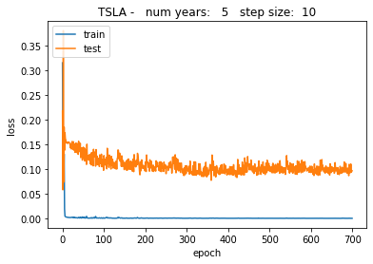
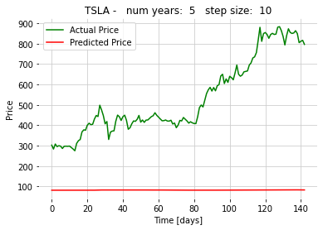
Experimentation - 5 Years Extended
Company: Tesla Duration: 5 years Time step: 50, 10 steps Batch size: 64 windows Feature set: Extended Epochs: 50

Slide 21
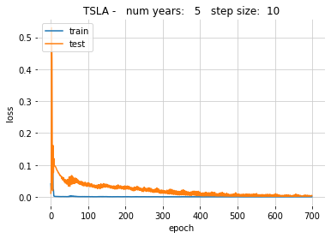
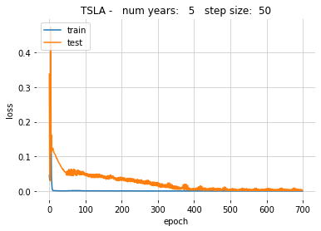
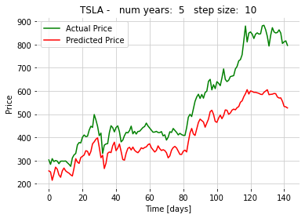
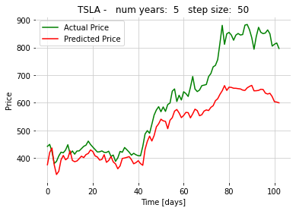
Experimentation - 5 Years Filtered
Company: Tesla Duration: 5 years Time step: 50, 10 steps Batch size: 64 windows Feature set: Filtered Epochs: 700

Slide 22
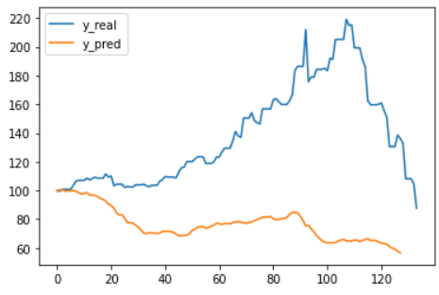
Results - Best Predictor
Based on information scraped from internet
Multilingual base for uncase sentiment
Training
prediction depends on the optimistic criteria of the investors

Slide 23
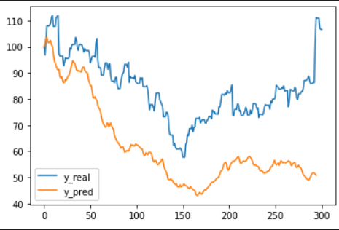

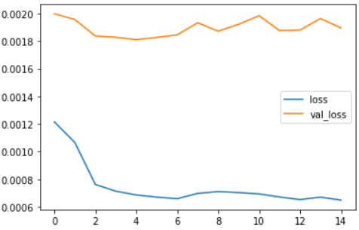
Results - Best Predictor
Training
Testing

Slide 24
General results
It is possible to differentiate 5 classes in the segmentations generated by the neural model.
The 64x64 image size allowed experimenting with data augmentation without consuming all the computer resources.
It took at least 50 epochs to obtain images similar to those in the label space.
Generated Images
Using images larger than 128x128 pixels exhaust the computer resources and limits the experiments that can be performed with data augmentation.
The mean IoU curves indicated a better performance in the experiments without data augmentation.
Performance metrics

Slide 25
Conclusion
The data augmentation algorithms impair the final performance of the model as shown by the metric curves.
Reducing the size of the source image reduces the resources required for its training but limits the effectiveness achieved.
The pix to pix loss function was the one with the best predicted label space continuity and is suitable for semantic segmentation applications
Potential for improvement given better conditions in the data source and computational resources, such as more classes predicted and more detail in the generated image.
Re-implementation of the code in TensorFlow 2.0 updates to state of the art platforms, from which subsequent developments can be made
Reduction in complexity of the code and integration of other tools for performance analysis

